Slide 1
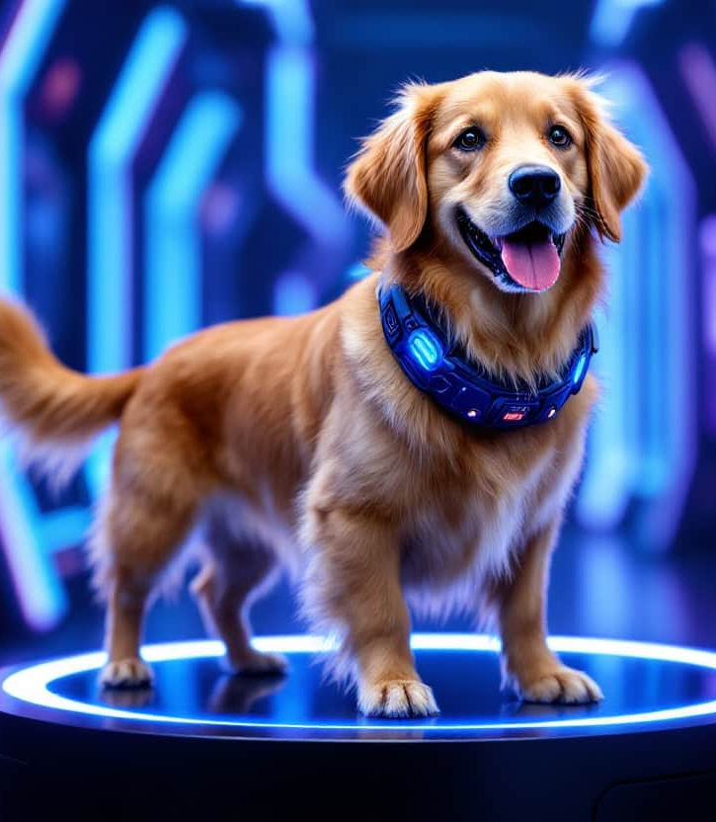
Pets Care Platform
Supervisors :
Dr. Ahmed Elsayed Yakoub
Eng. Khaled Mohamed Mahmoud

Slide 2

Team Members
Mohamed Ashraf Erfan → (21-01148)
Mahmoud Alsoudy Ahmed → (21-00911)
Bahaa Mahmoud Helmy → (21-00550)
Ahmed Mohamed Abd Elnasser → (21-00376)
Ziad Ismail Ibrahim → (21-02291)
Ahmed Zain Alabidin Abdelaziz → (21-00326)
Ahmed Alaa Othman Hashem → (2100340)

Slide 3


Global Pet Care Market Growth (2015-2024)
Steady Market Growth: The pet care industry has expanded consistently from 2015 to 2024.
Key Growth Factors:
Increasing pet ownership worldwide.
Greater awareness of pet health and wellness.
The humanization of pets, leading to higher spending.
Post-2019 Surge:
A sharp increase in market size, likely due to the COVID-19 pandemic.
More people adopted pets and spent more on their care.
Market Expansion:
Demand for pet-related products and services has risen, including food, grooming, veterinary care, and accessories.
By 2024, the market has surpassed $250 billion, showcasing its resilience.
Future Outlook:
As disposable income increases, pet owners continue to prioritize high-quality care.
The industry is expected to keep growing in the coming years.

Slide 4
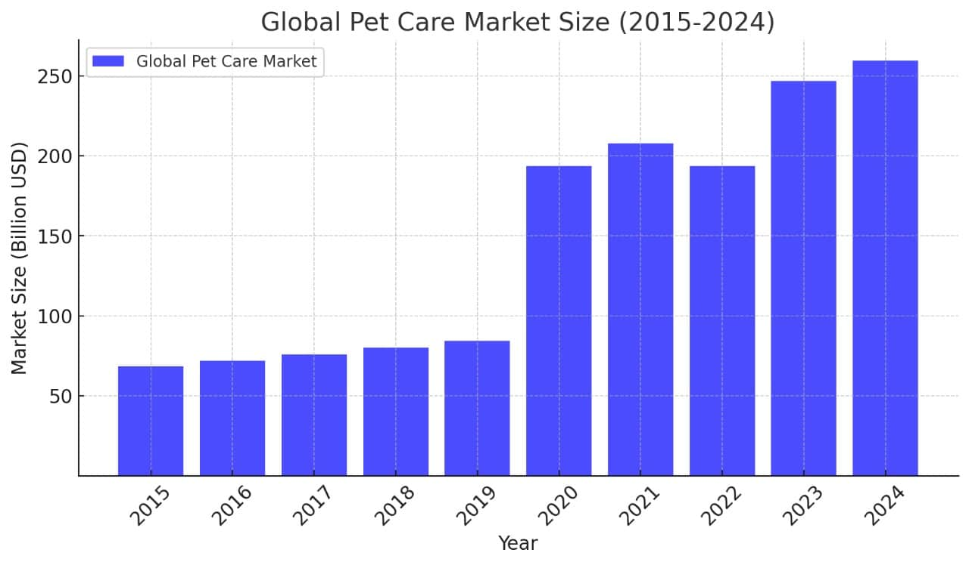
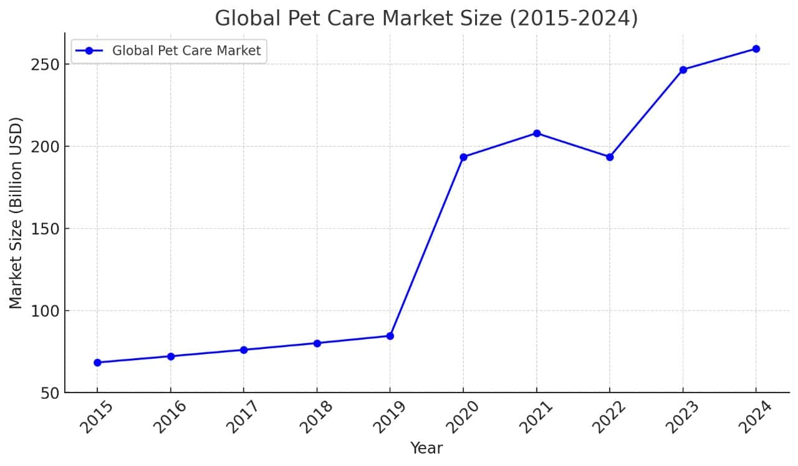


Global Pet Care Market Growth (2015-2024)

Slide 5
Middle East Pet Care Market Overview
Middle East Pet Care Market Overview
This bar chart highlights the growth of the pet care industry in the Middle East.
Total Market Size (2022): $3.35 billion, covering all pet-related expenditures.
Pet Food Market (2022): $955.8 million, showing the food segment's share.
Pet Food Market Projection (2031): Expected to reach $1.5 billion, indicating strong growth.
The chart visually compares these values, emphasizing the expanding pet care industry and increasing demand for pet food in the region.

Slide 6
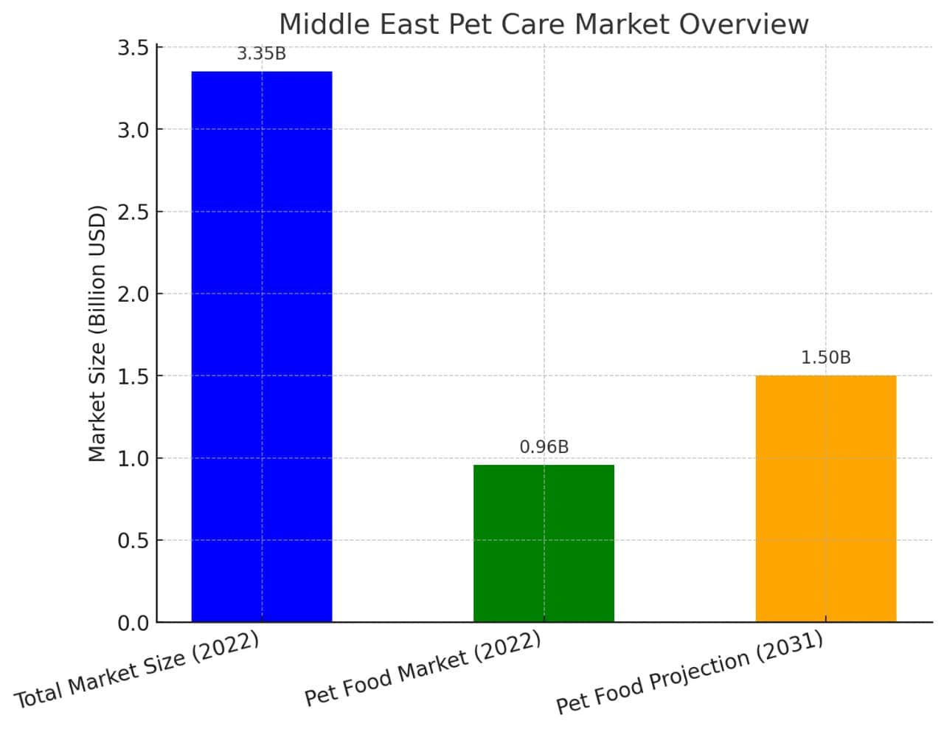
Middle East Pet Care Market Overview

Slide 7


Market size: $13.7 million (2022), expected to reach $15.3 million (2023), with 7.3% CAGR growth.
Pet ownership is rapidly increasing, making Egypt one of the fastest-growing markets.
66.8% of pet owners use veterinary services, and 36.5% use grooming services.
Egypt Pet Care Market Overview

Slide 8
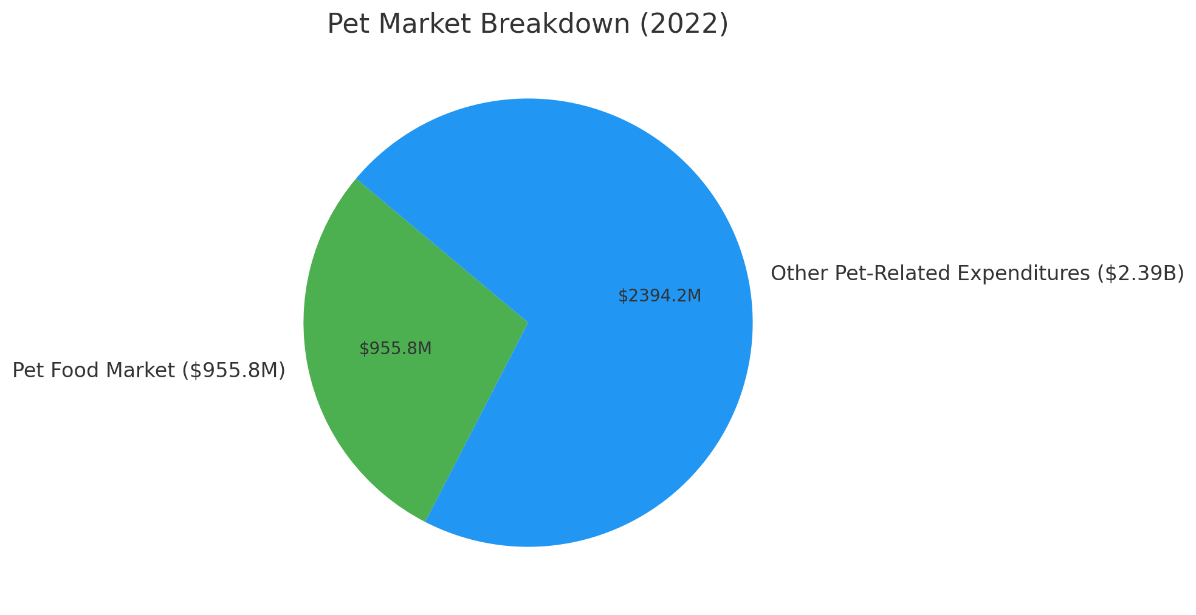
Egypt Pet Care Market Overview

Slide 9
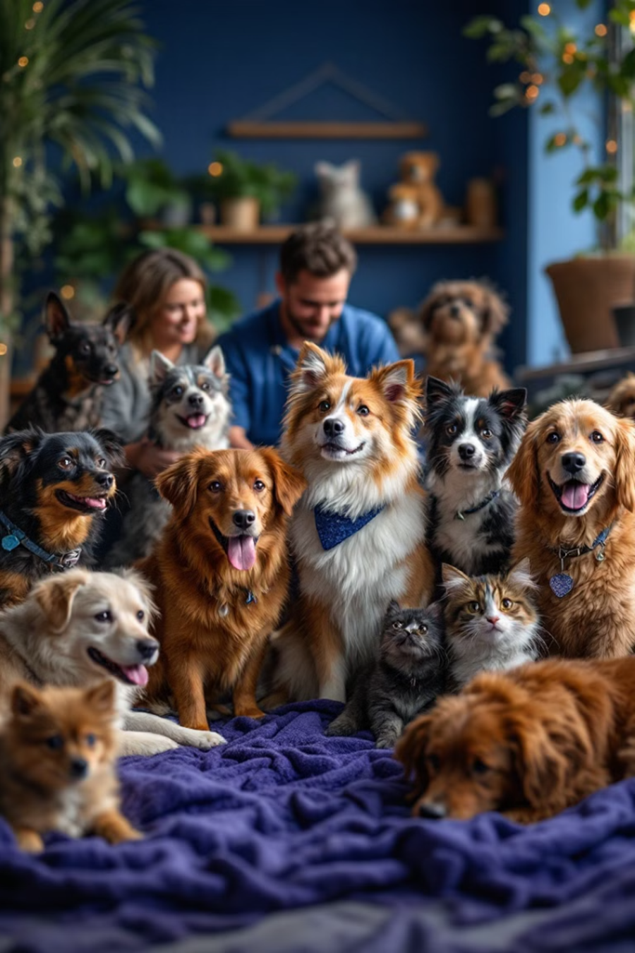
Pets Care Platform Is The Solution

Slide 10
Pet Adoption Listings
Community Features
E-commerce
Appointment Booking
Capability to purchase pet-related items, such as Accessories or food.
Users can book appointments for pet services (e.g., veterinary visits, grooming) with available time slots.
displays available pets for adoption with descriptions, photos, and basic details (age, breed, etc.).
Post , Comment and reply features for articles or forum.
Also can appointments for pet services Training
What We Do

Slide 11
Travelling
AI helper
checking what is in the photo if it is animal or something else
checking the features of the disease of the animal if the disease is dangerous to the animal or not
checking statement of animal if the pet can be adopted or not
Pet Care Resources
Articles, guides, and videos on pet care, training, nutrition, etc.
Instructions to travelling with your pet to any country
Predict the expected price of the pet
What We Do

Slide 12
Gap Analysis & literature view
 | PetSmart | Petco | Chewy | Petfinder | Vetstreet | Zoolker | Aleef | Pets Care
Pet Clinics | x | ✓ | x | x | x | ✓ | x | ✓
Adoption Services | ✓ | ✓ | x | ✓ | x | ✓ | x | ✓
AI Classification Model | x | x | x | x | x | x | x | ✓
Food Categories | ✓ | ✓ | ✓ | x | x | x | ✓ | ✓
Training and Behavior Services | ✓ | ✓ | x | x | ✓ | x | x | ✓
Pet Lovers Community Forum | x | x | x | x | x | x | x | ✓
E-commerce for Pet Supplies | ✓ | ✓ | ✓ | x | x | x | ✓ | ✓
Pet Travel Procedures | x | x | x | x | x | x | x | ✓
Common Features | 4 | 5 | 2 | 1 | 1 | 2 | 2 | 8

Slide 13


AI Models Accuracy

Slide 14
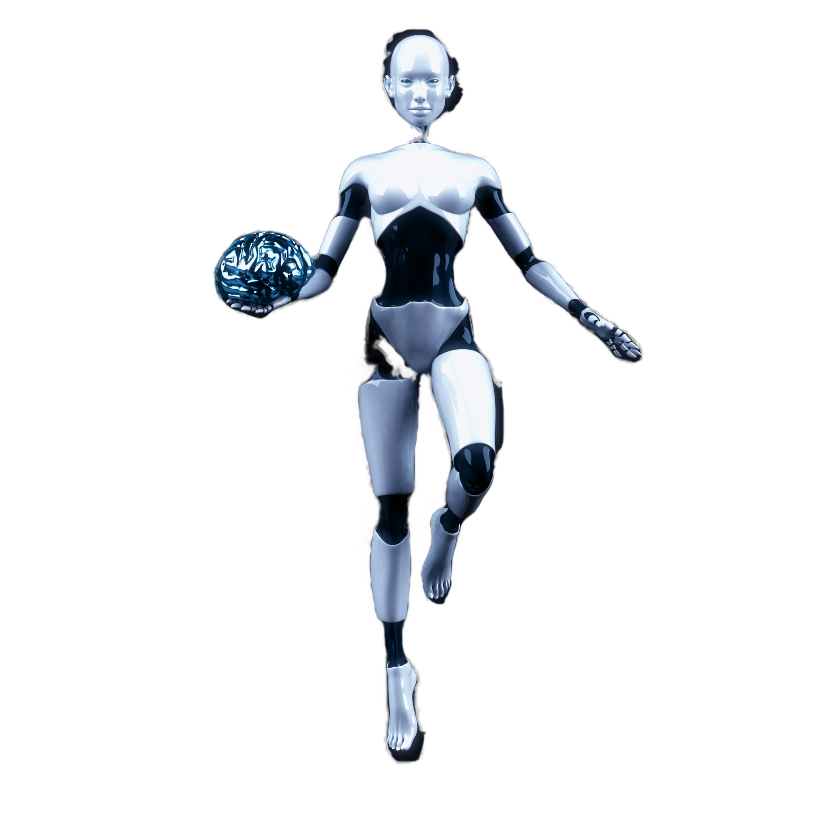
AI Model for Predicting Pet Prices
Goal: Develop an AI model to predict pet prices accurately.
Data Processing:
Source: "pet_price_dataset.csv"
Cleaned: Removed missing values
Preprocessed: Label Encoding & Standard Scaling
Split: Training & Testing sets
Algorithms Tested:
Linear Regression, Random Forest, SVR, XGBoost
Best Model: XGBoost Regressor
Higher accuracy, handles complex data, minimizes errors, supports Gradient Boosting
Evaluation Metrics: MAE, MSE, R² Score

Slide 15
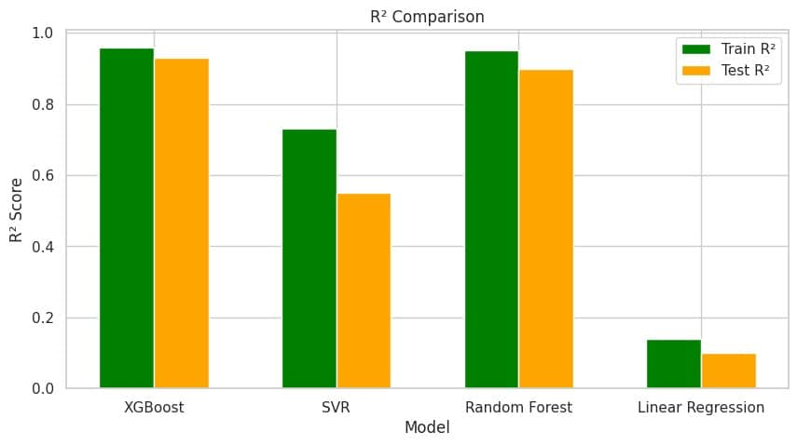

AI Model for Predicting Pet Prices

Slide 16
Importance
Helps shelters optimize resources and improve adoption rates.
Goal: Develop an AI model to predict pet adoption based on various features.
Data Processing
Source: "pet_adoption_data.xlsx"
Cleaning: Handled missing values for better data quality.
Preprocessing: Applied Label Encoding & Standard Scaling for improved performance.
Splitting: Divided data into Training & Testing sets for evaluation.
Algorithms Tested
Decision Tree Classifier
Random Forest Classifier
Support Vector Classifier (SVC)
Logistic Regression
Best Model: Decision Tree
Higher accuracy compared to other models.
Handles categorical & numerical data efficiently.
Reduces overfitting by using multiple decision trees.
Provides feature importance insights.
Evaluation Metrics
Accuracy Score
Classification Report (Precision, Recall, F1-score)
Confusion Matrix
AI Model for Predicting Pet Adoption Possibility

Slide 17

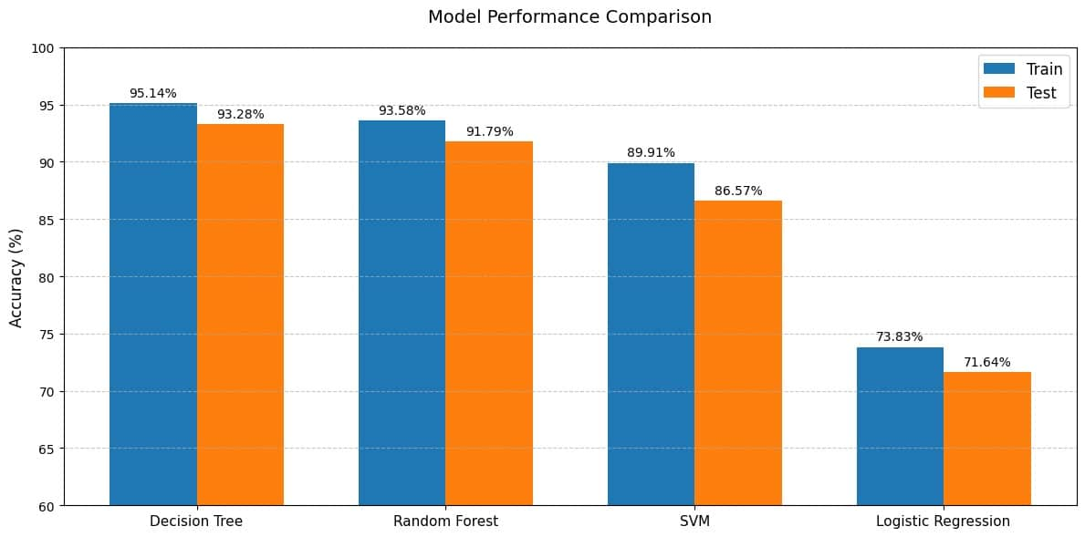
AI Model for Predicting Pet Adoption Possibility

Slide 18
Dataset Preparation Images of cats and dogs were collected, organized into separate folders, and cleaned by removing low-quality or duplicate images.
Image Preprocessing Images were resized to 224x224, normalized to [0, 1], and loaded in batches using an Image Data Generator.
Model Architecture A pre-trained MobileNetV2 (from ImageNet) was used as the base. Original layers were replaced with a GlobalAveragePooling2D layer and a Dense layer with sigmoid activation for binary classification. The base layers were frozen.
Model Training The model was compiled using the Adam optimizer and Binary Crossentropy loss. It was trained for 5 epochs, using accuracy as the performance metric.
Model Saving The trained model was saved as dog_cat_classifier.h5 for future use without retraining.
Model Testing A new image was resized, normalized, and passed through the model. Output > 0.5 indicated a dog, otherwise a cat.
Algorithm Comparison Traditional ML models (e.g., Decision Trees, Random Forest, Logistic Regression) are not suitable for image classification due to high-dimensional data and poor performance on raw images.
Cat and Dog Image Classification using MobileNetV2 and TensorFlow

Slide 19
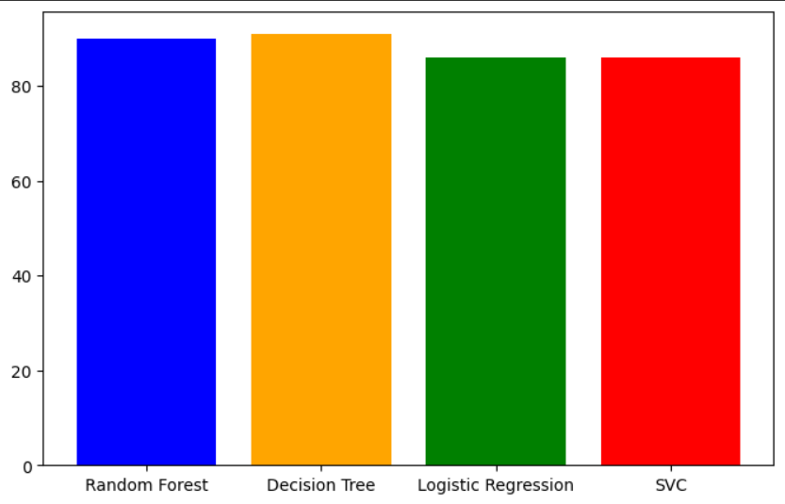
AI Model for Predicting Pet the Danger

Slide 20


System Analysis

Slide 21
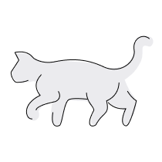
1- Use Case

Slide 22

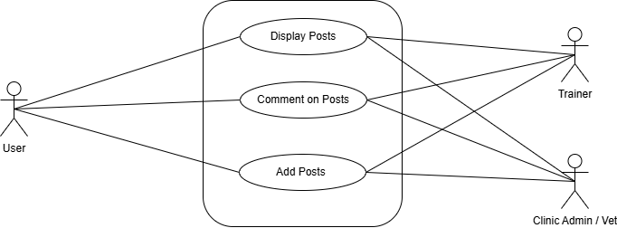
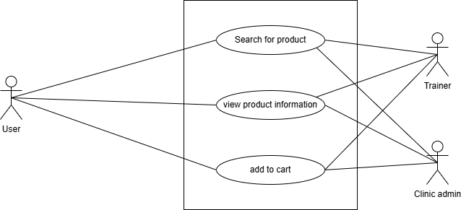
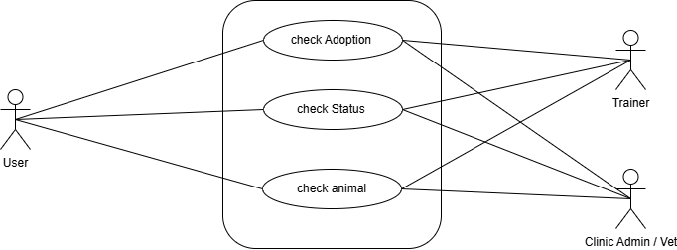
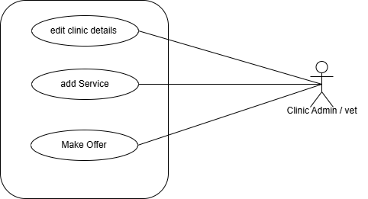
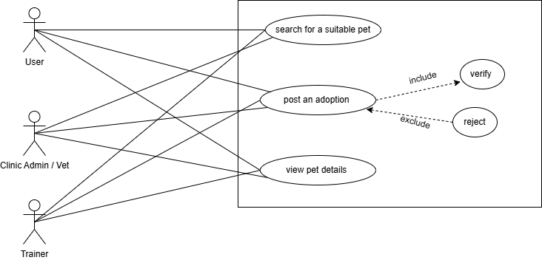

Community
E-commerce
AI Helper
Clinics Profile
Adoption Services

Slide 23
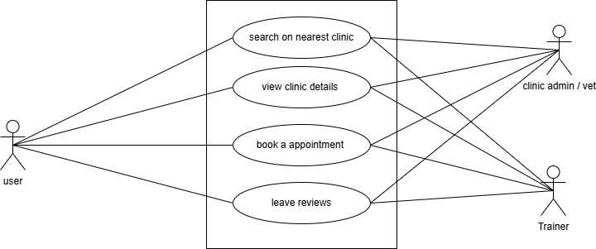
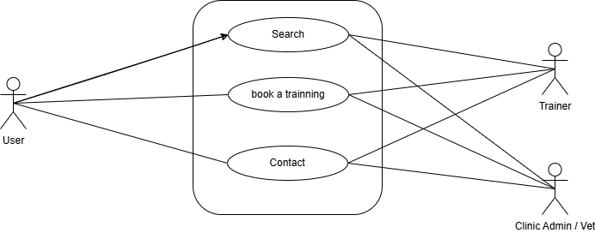
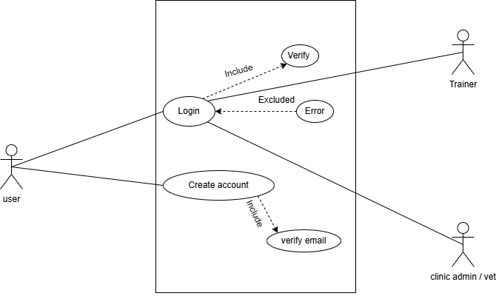
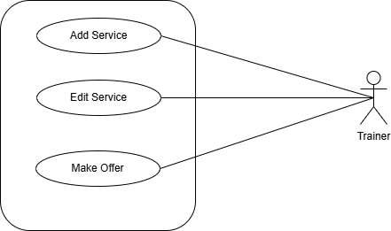
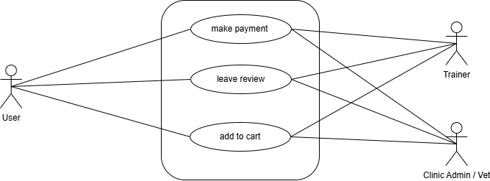
Pet Clinics Directory
Training Directory
Login & Registration
Training Profile
Product Page

Slide 24
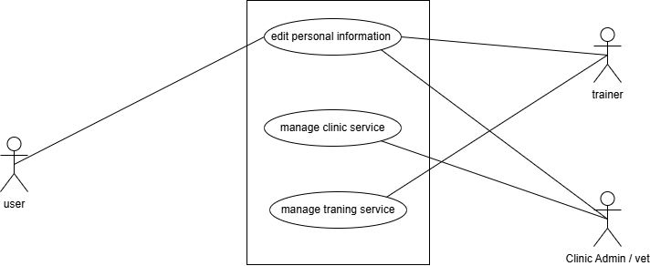
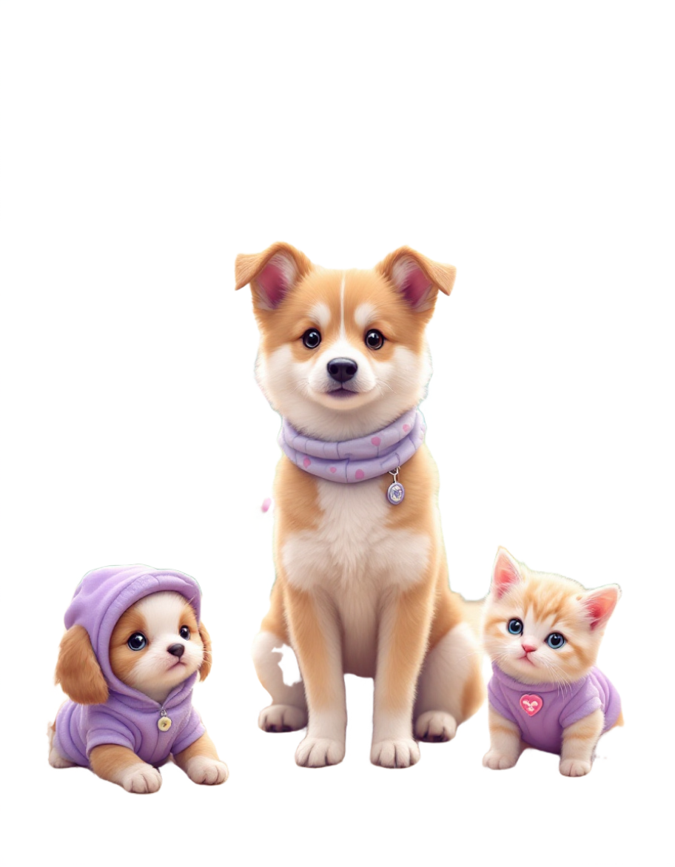
Profile

Slide 25
2- Activity Diagram

Slide 26
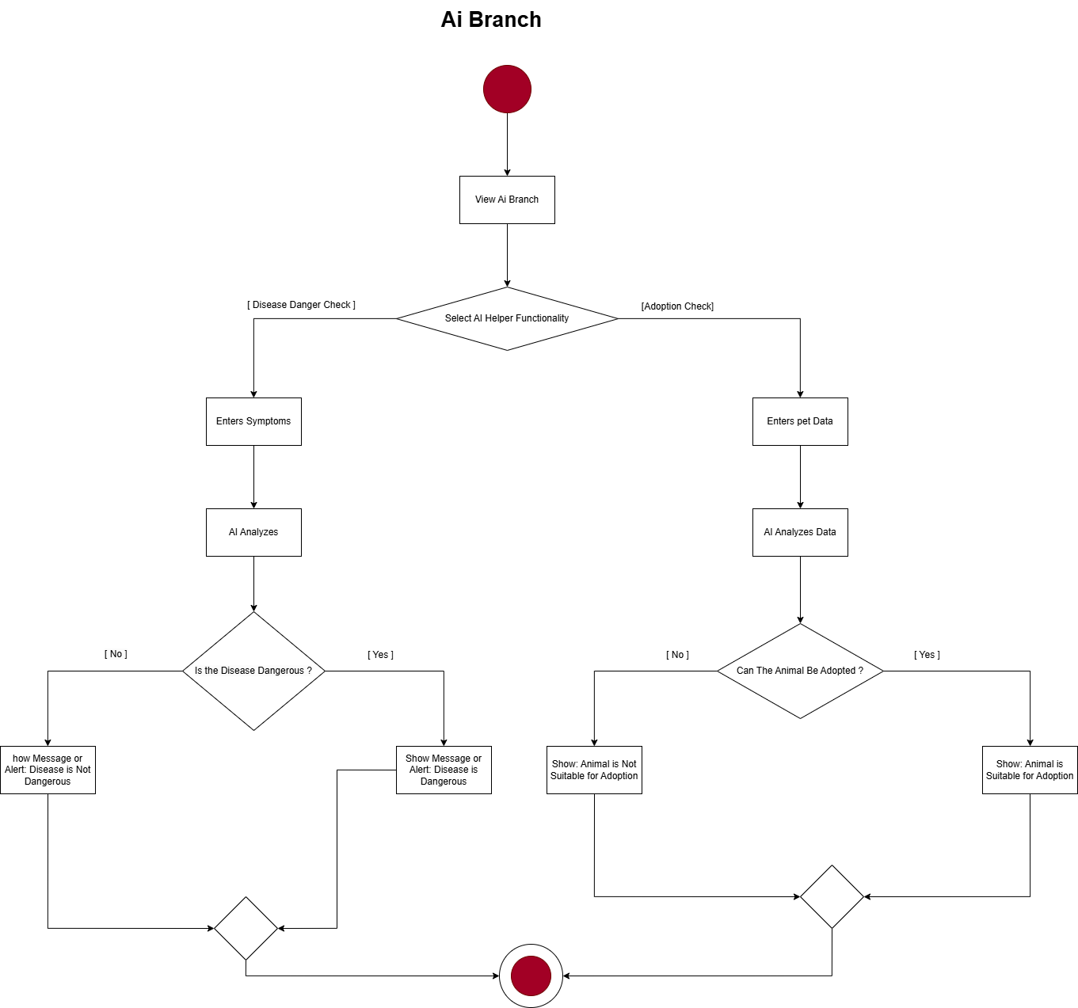

AI Helper

Slide 27
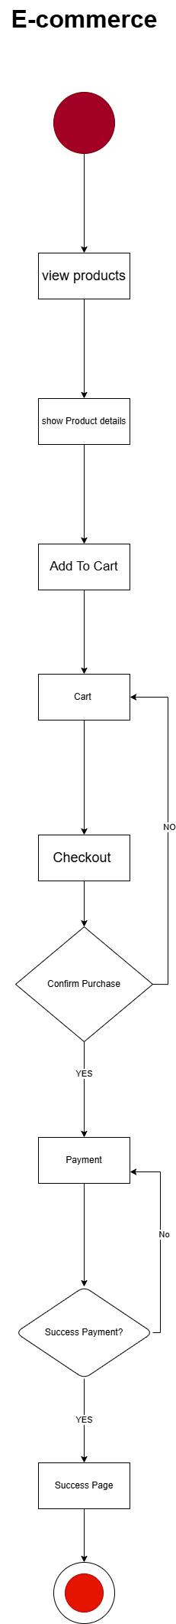
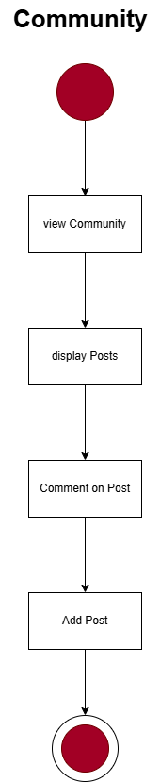
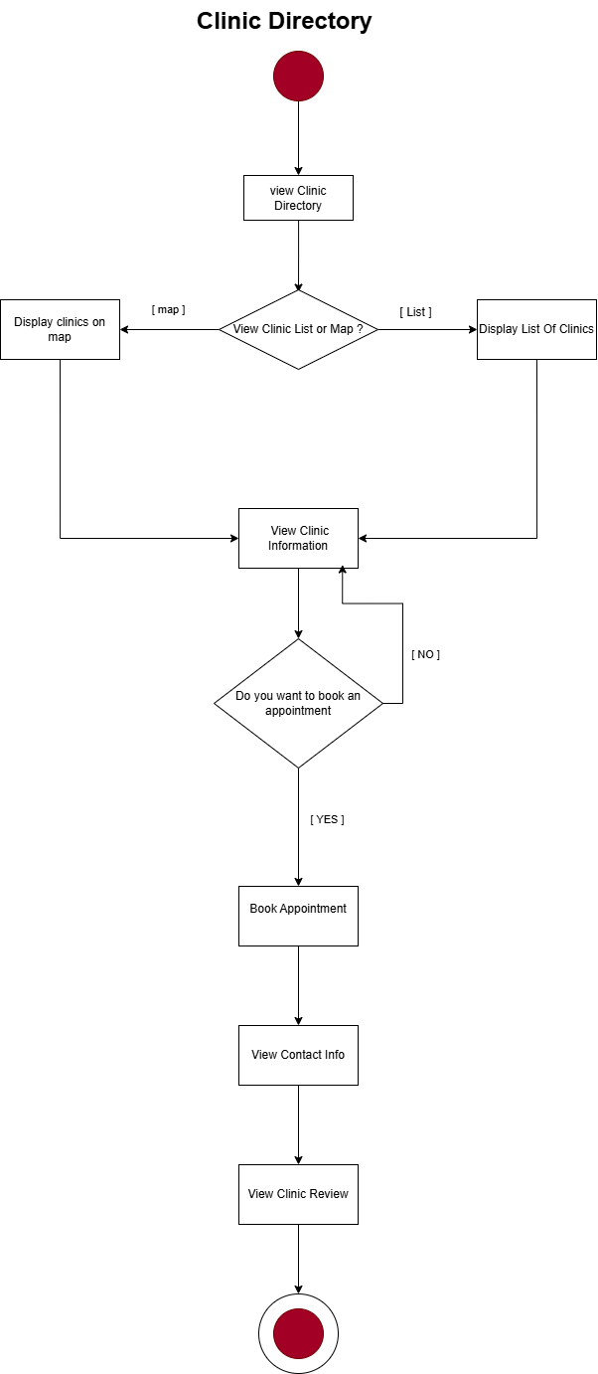
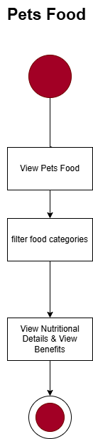

Slide 28
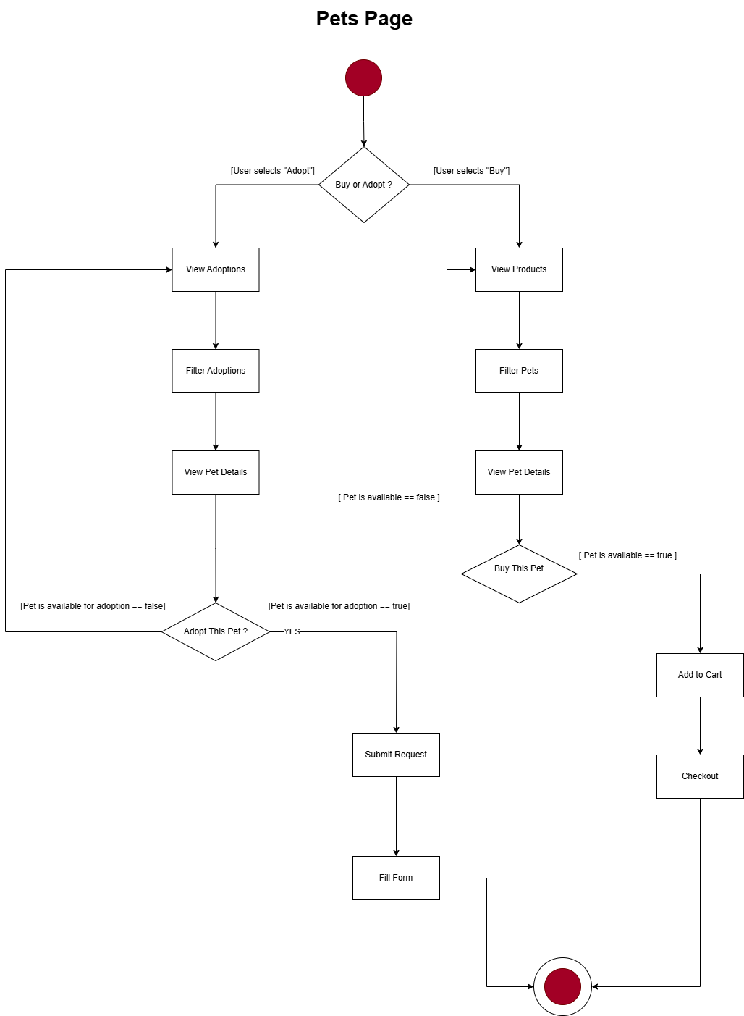

Slide 29
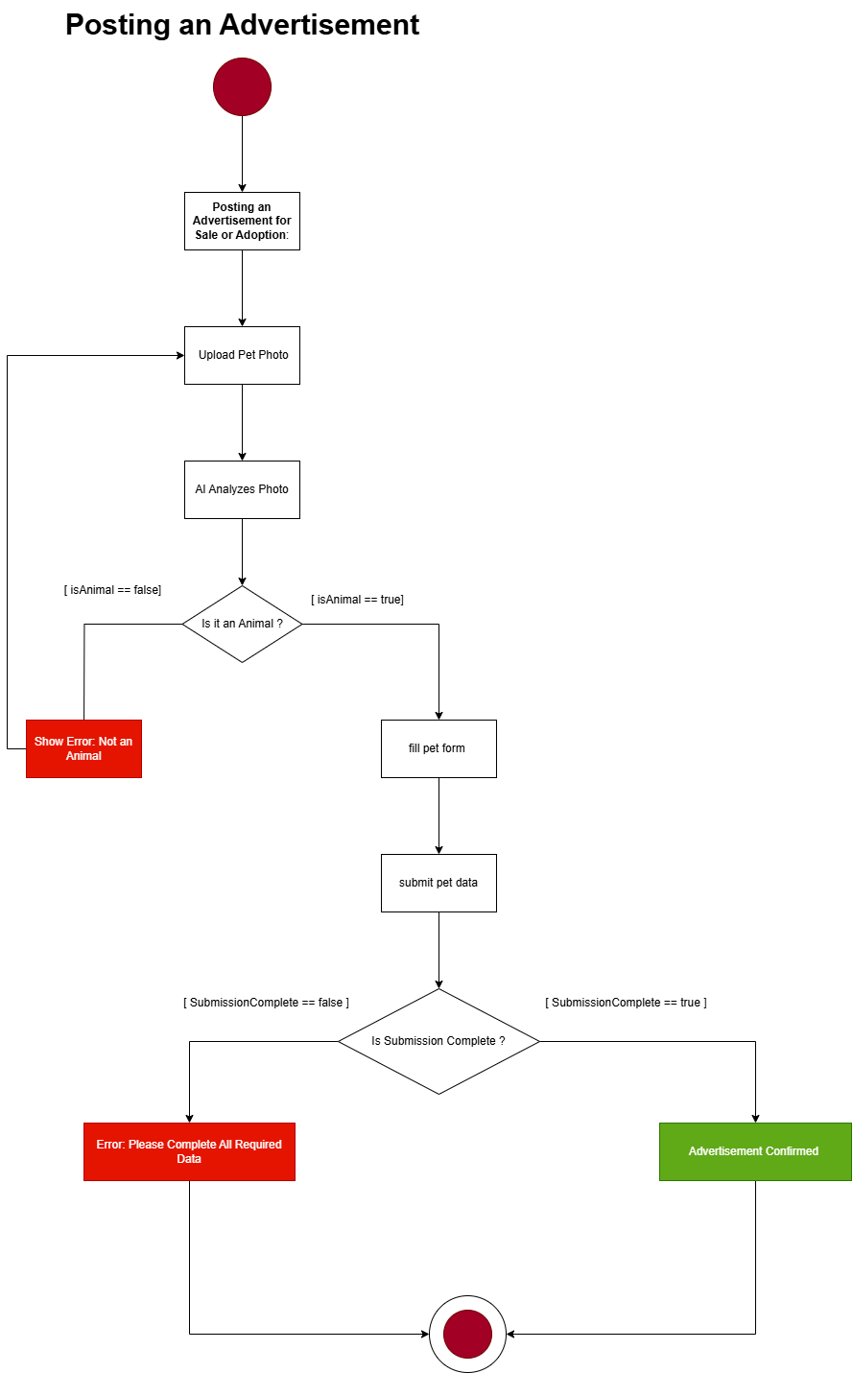
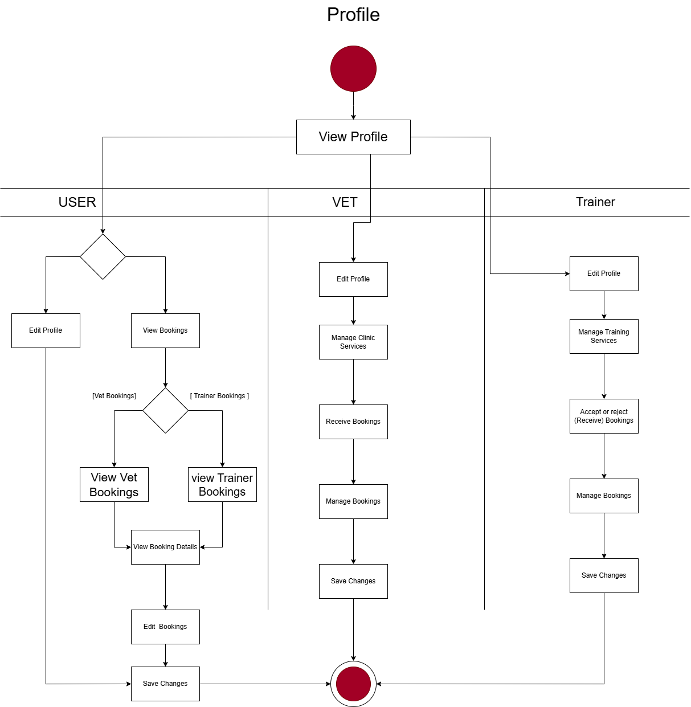

Slide 30
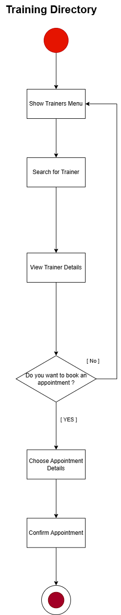
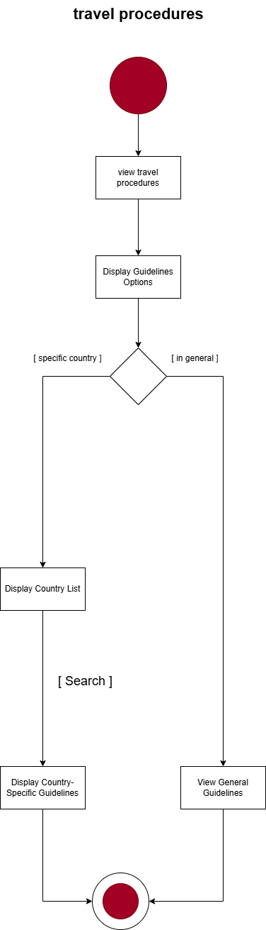


Slide 31
3- State Machine Diagram

Slide 32
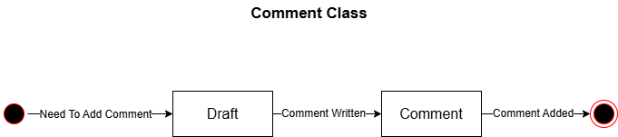
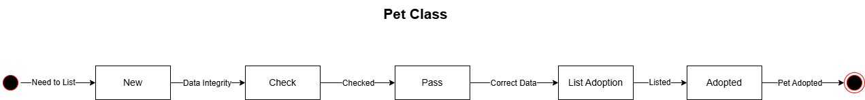


Slide 33
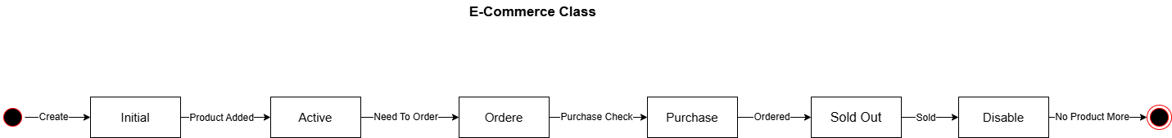
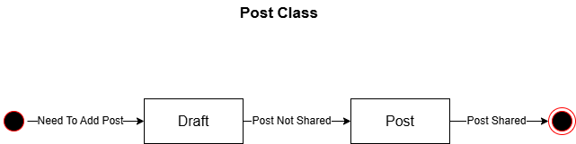
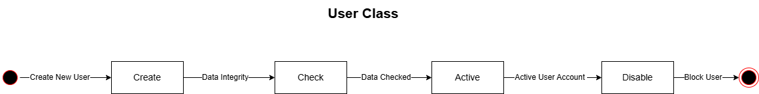

Slide 34
4- Class Diagram

Slide 35
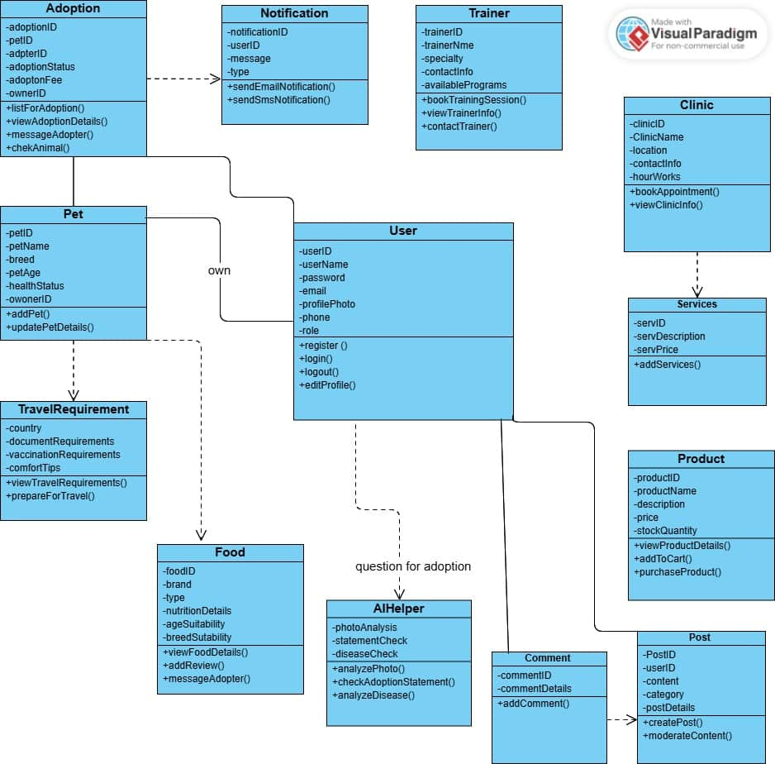

Slide 36
5- Sequence Diagram

Slide 37
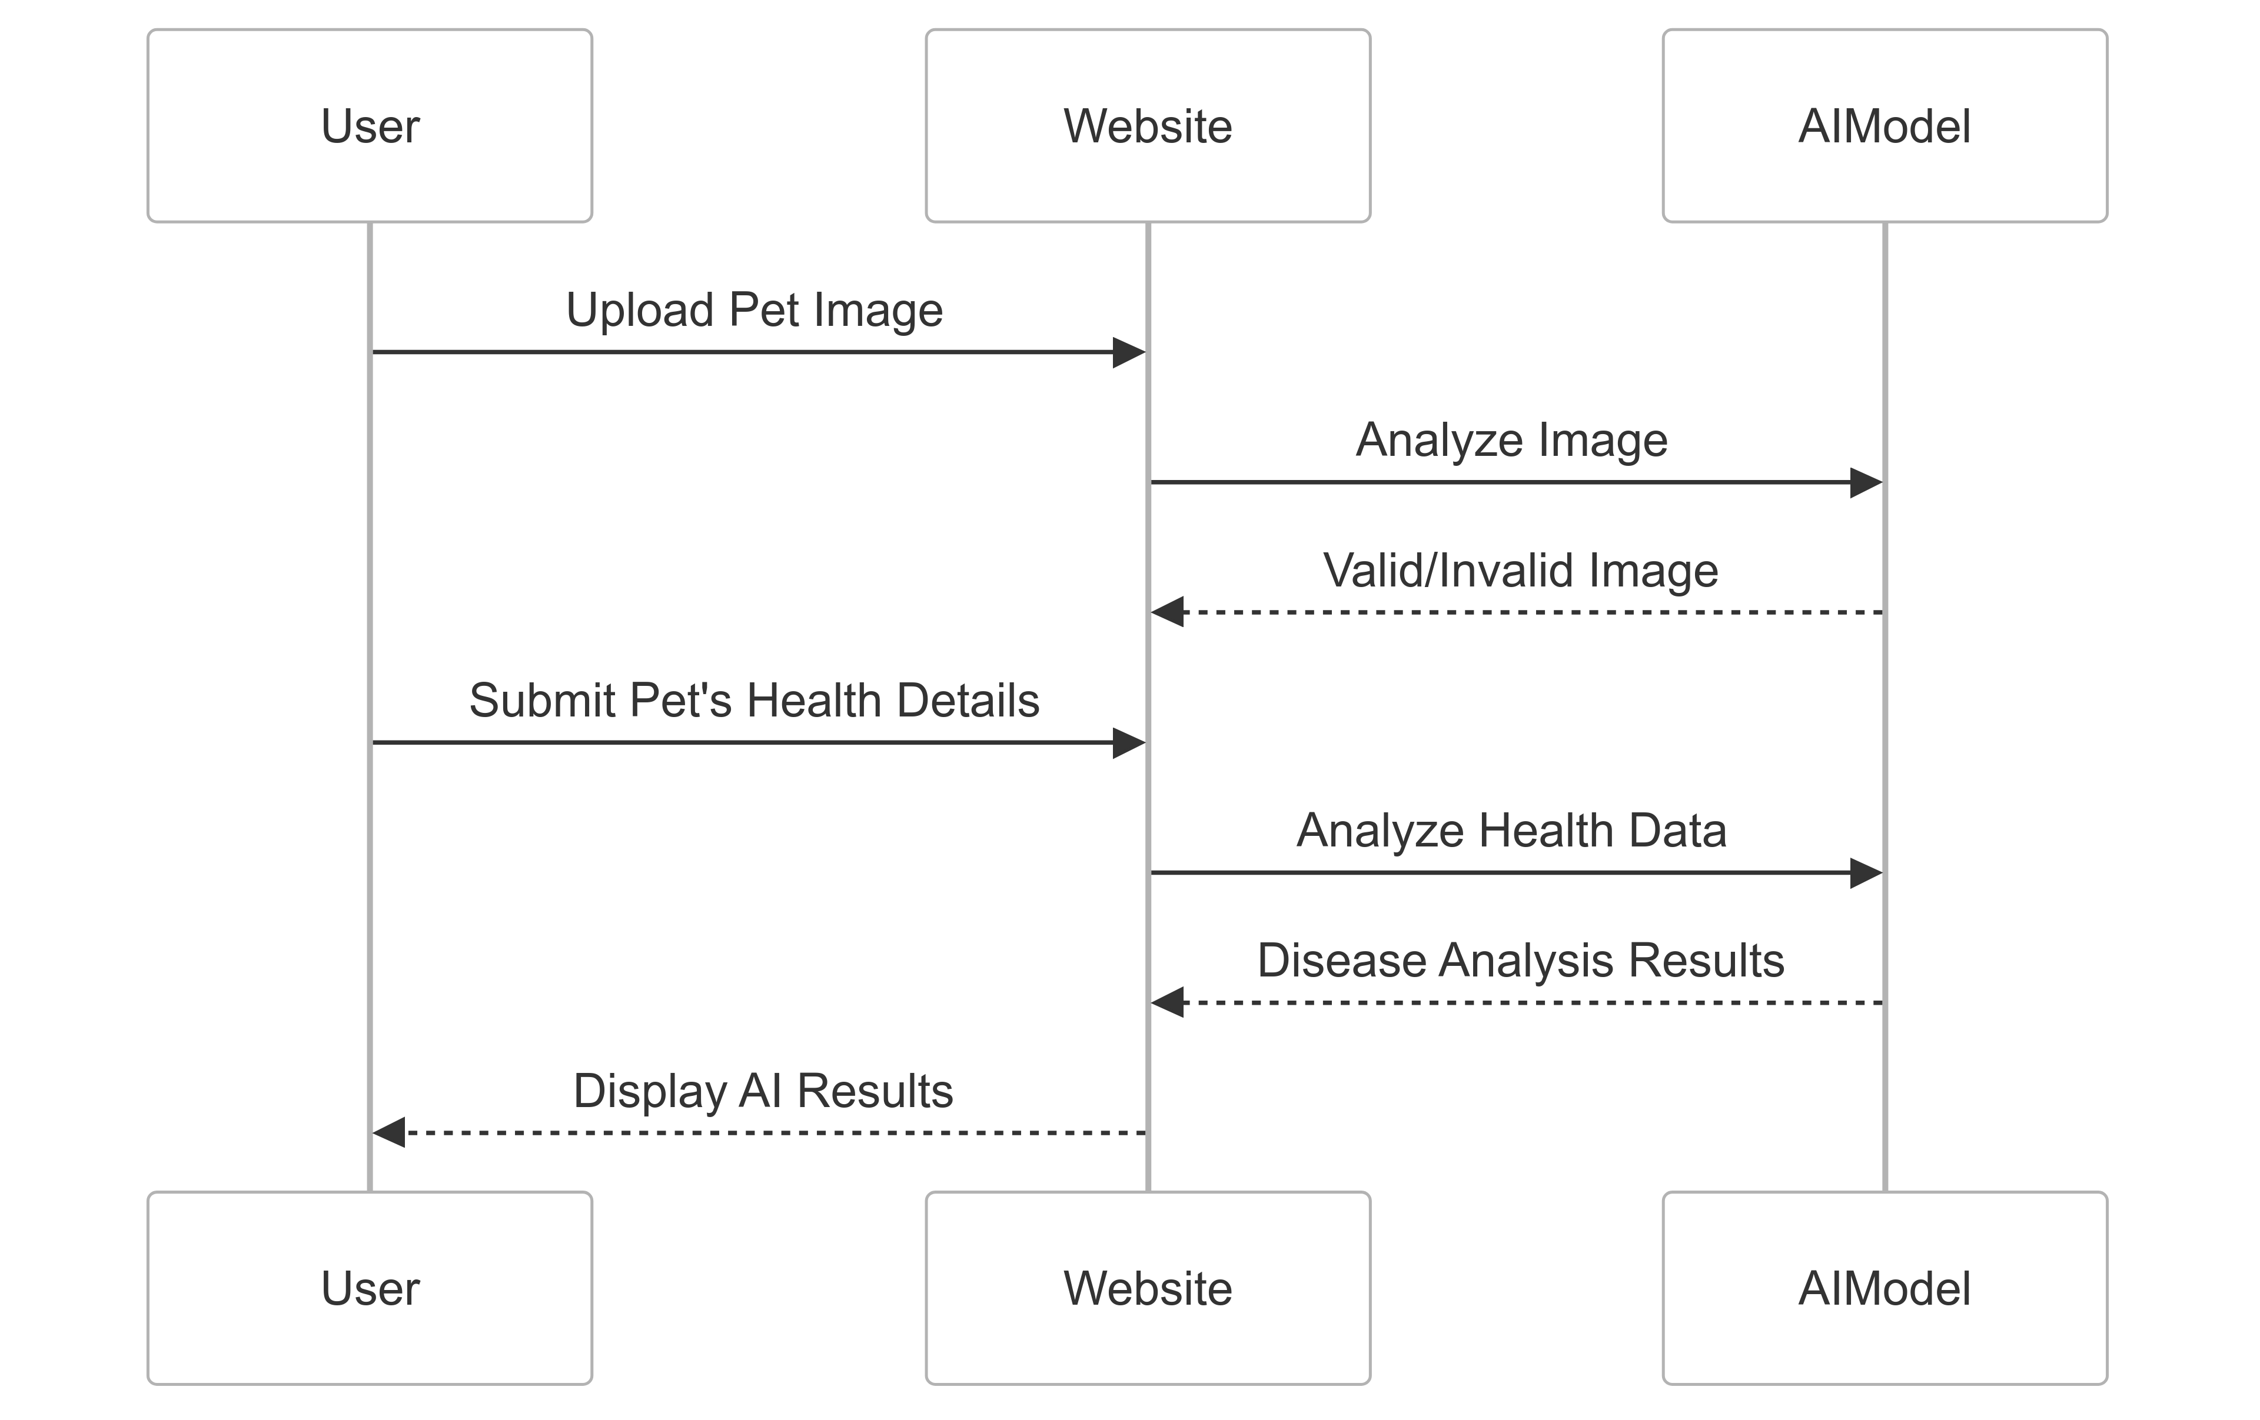
AI Helper

Slide 38
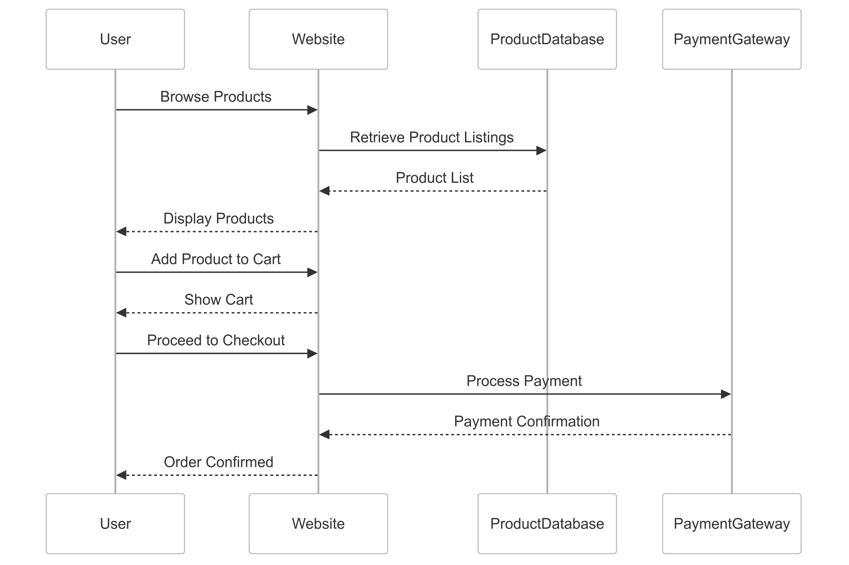
E-Commerce

Slide 39
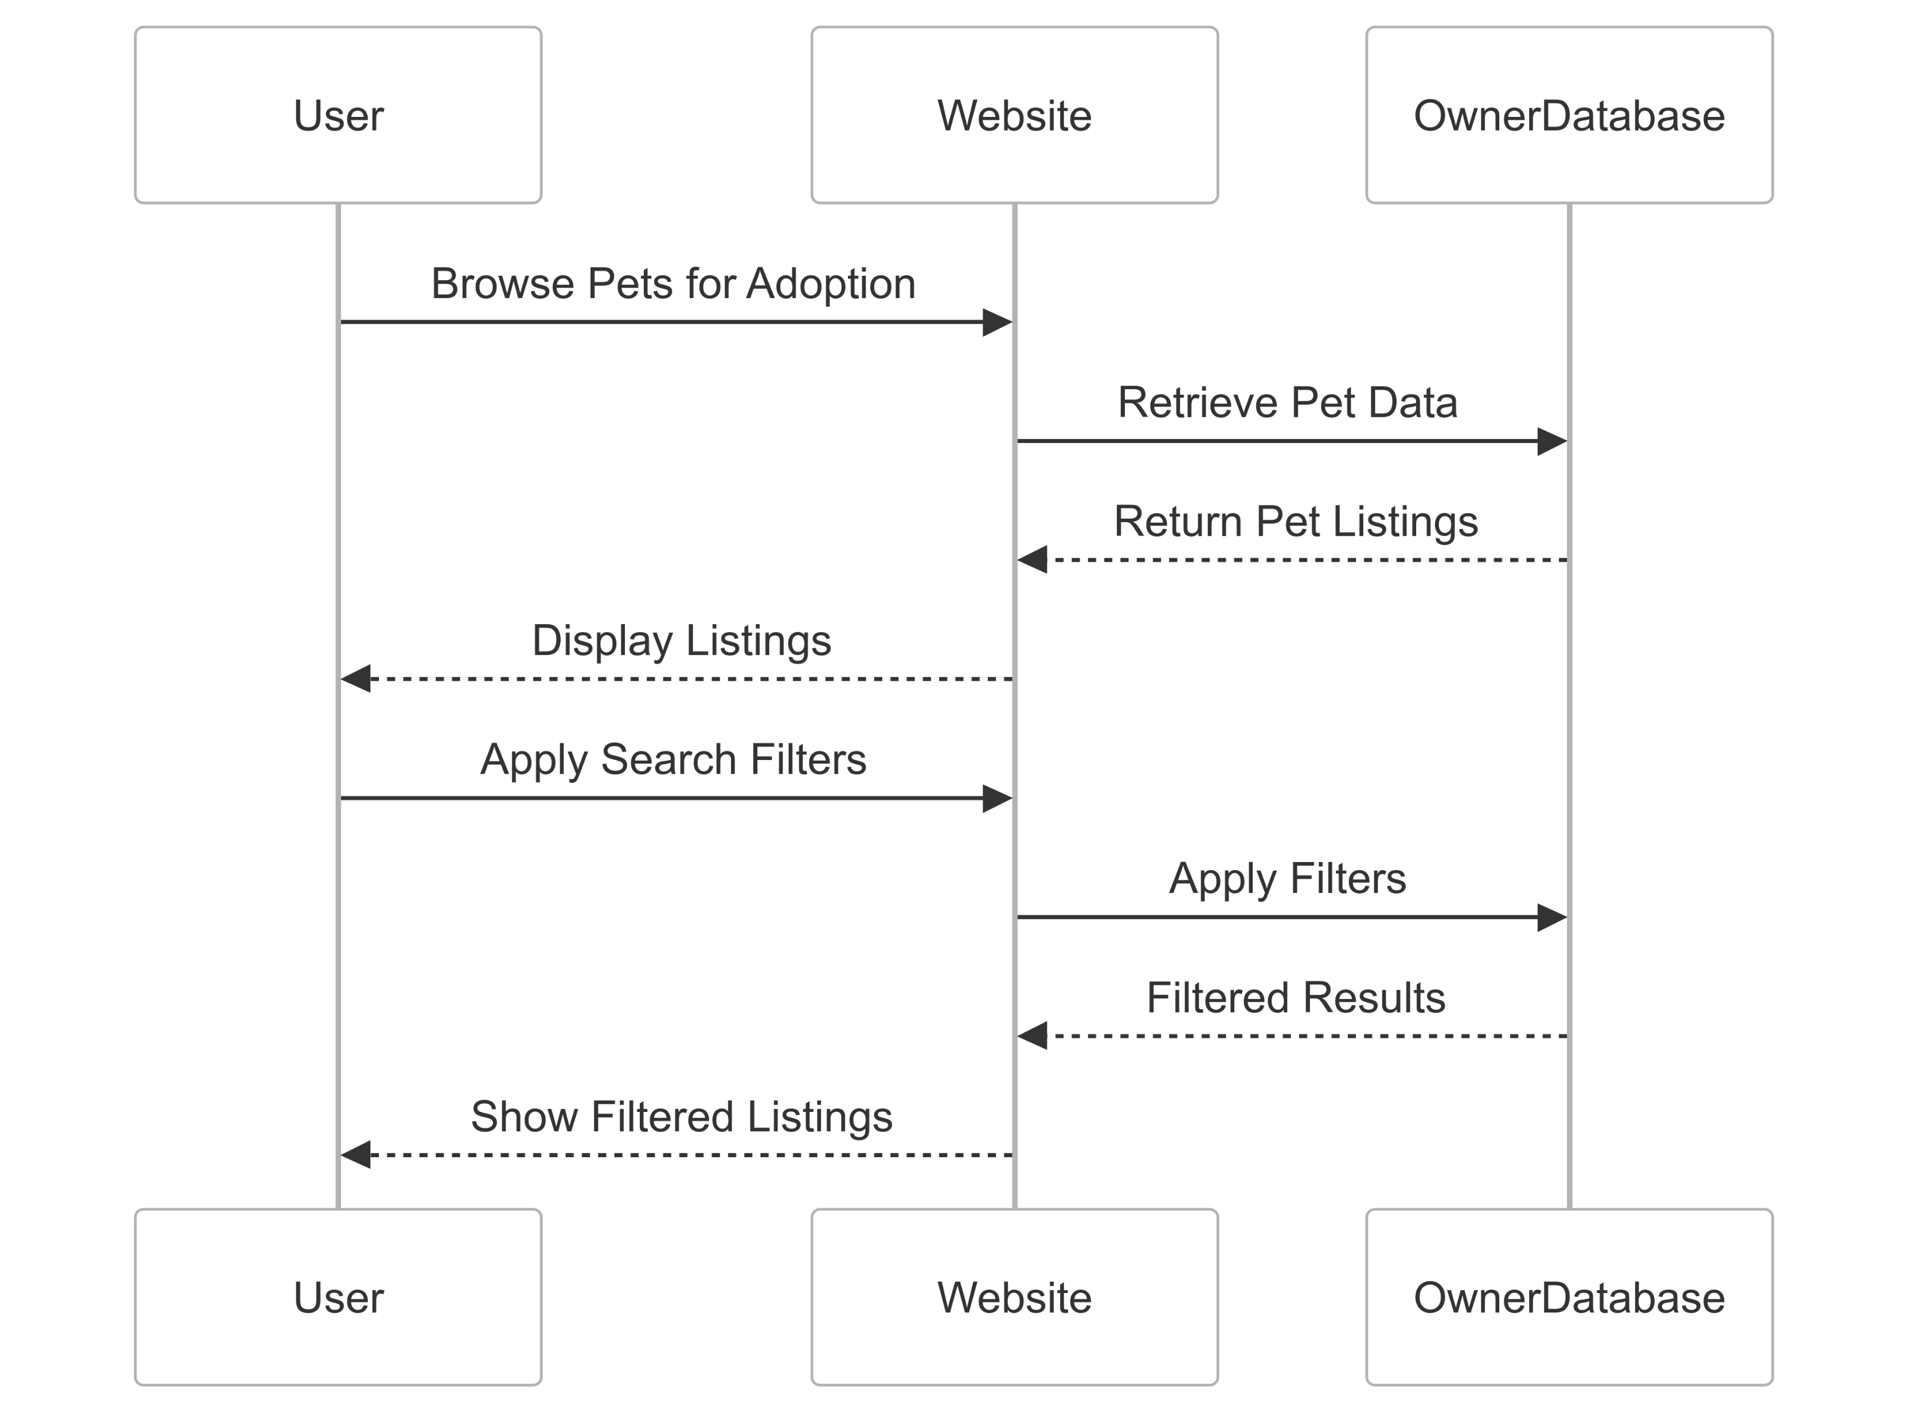
Adoption Services

Slide 40
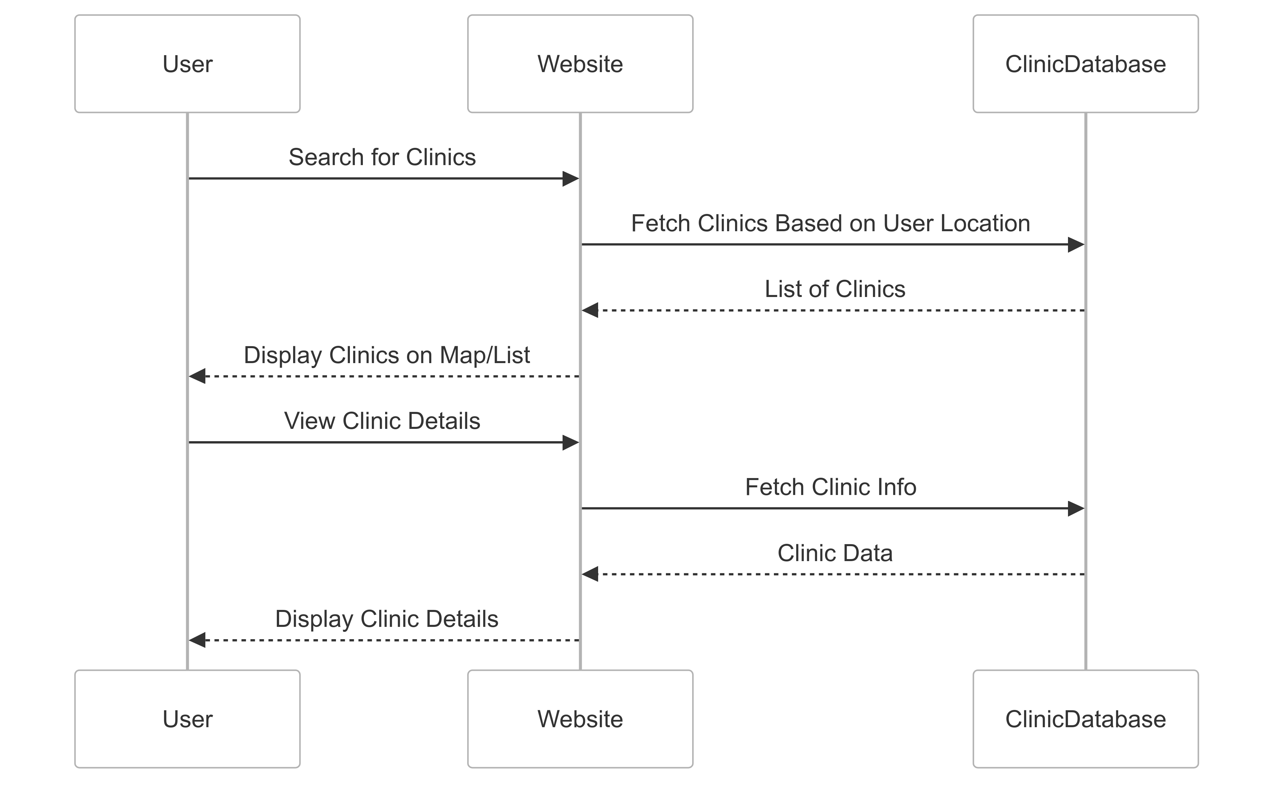
Clinics

Slide 41
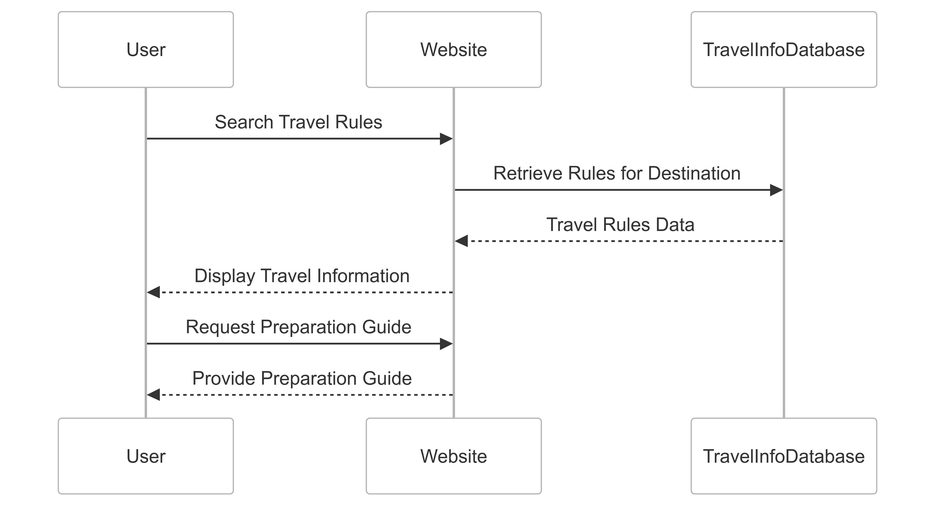
Travel Procedures

Slide 42
Implementation

Slide 43
Technologies, Tools, and Programming Languages
Frontend:
HTML, CSS, JavaScript
React.js for reusable UI components (e.g., pet cards, dashboards)
Backend:
Node.js + Express.js for scalable server/API
MongoDB for flexible, schema-less pet data
Version Control & Tools:
Git + GitHub (collaboration & versioning)
NPM (dependency management), Postman (API testing), VS Code (IDE)
Deployment: Heroku (assumed), optional: AWS for image storage
Optional (Mobile & Cloud):
React Native or Flutter for mobile
AWS (S3, EC2) for scalability

Slide 44
Key System Modules (1/2)
User Management:
Pet Profile:
Care Reminders:
Purpose: Registration, login, and profile updates
Purpose: Manage pet details (breed, medical history)
Purpose: Task alerts (feeding, vet visits)
Tech: JWT, bcrypt (security), MongoDB, React forms
Tech: MongoDB, React UI (cards/tables)
Tech: node-cron (scheduling), MongoDB, React calendar
API Routes: /api/users/*
API Routes: /api/pets/*
API Routes: /api/reminders/*

Slide 45
Key System Modules (2/2)
Health Tracking:
Community / Advice:
Purpose: Log metrics (weight, symptoms), visualize trends
Purpose: User posts, care tips, discussions
Tech: Chart.js + MongoDB, Express
Tech: MongoDB forums + React thread views
API: /api/health/logs
API: /api/community/*
Interconnection:
All modules linked via RESTful APIs
JWT for secured access
Modules connect through shared IDs (e.g., userId, petId)

Slide 46

Challenges and Solutions
Challenge
Solution
Flexible pet data schema
Used MongoDB + standard JSON formats
Responsive UI
Bootstrap + React + BrowserStack testing
API rate limiting
Redis caching for frequent calls
Authentication security
JWT + bcrypt for secure sessions
⚙️ Focused on modularity, scalability, and secure architecture for a smooth pet care experience.

Slide 47
Interfaces
UI & UX

Slide 48
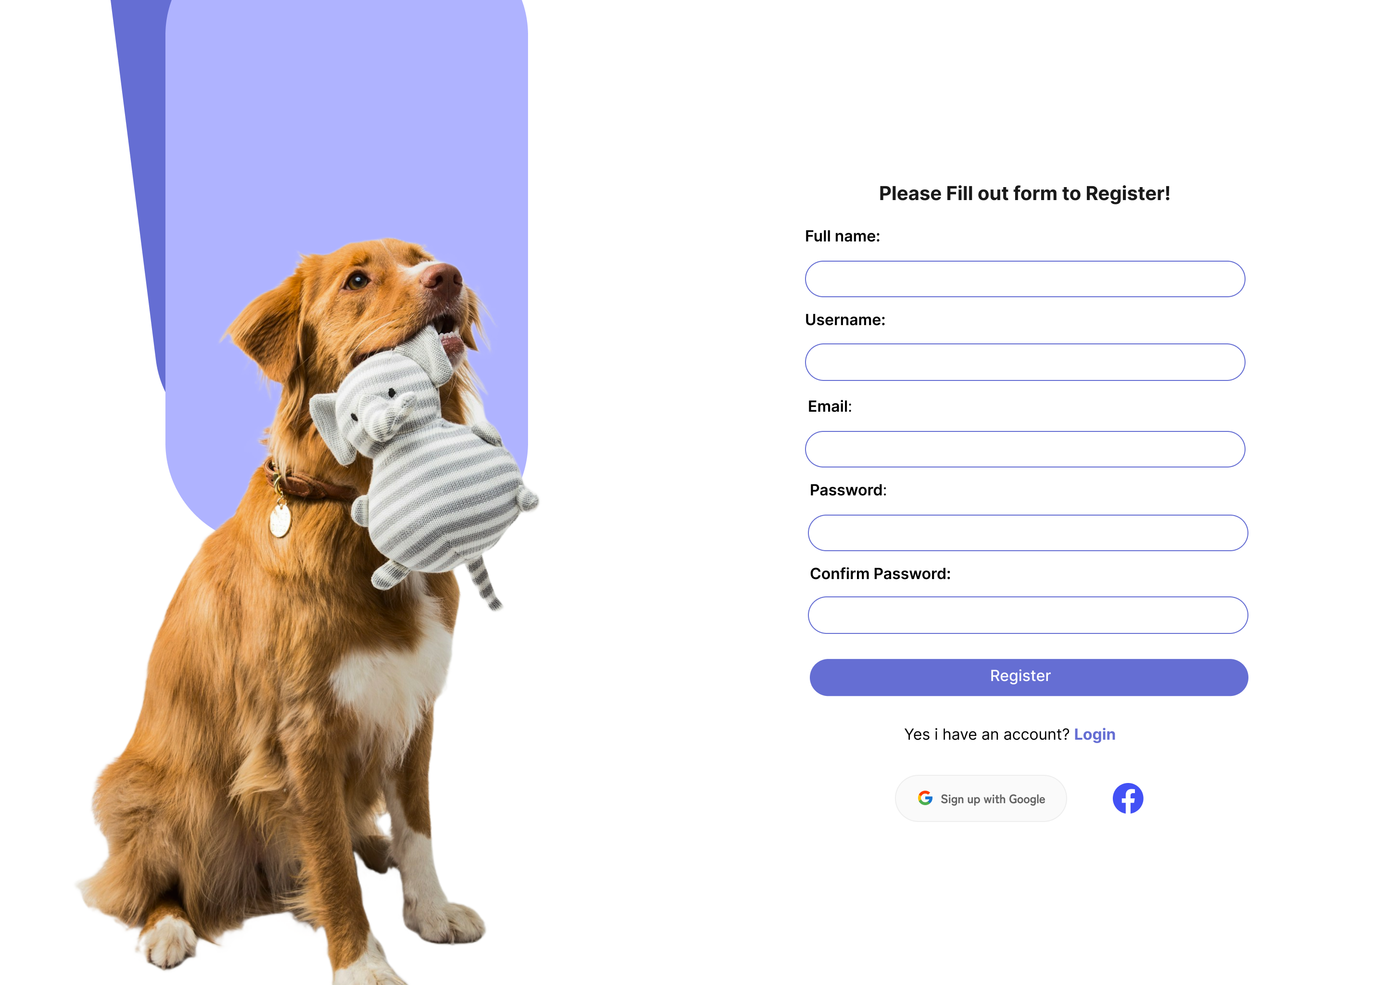
Registration
Page

Slide 49
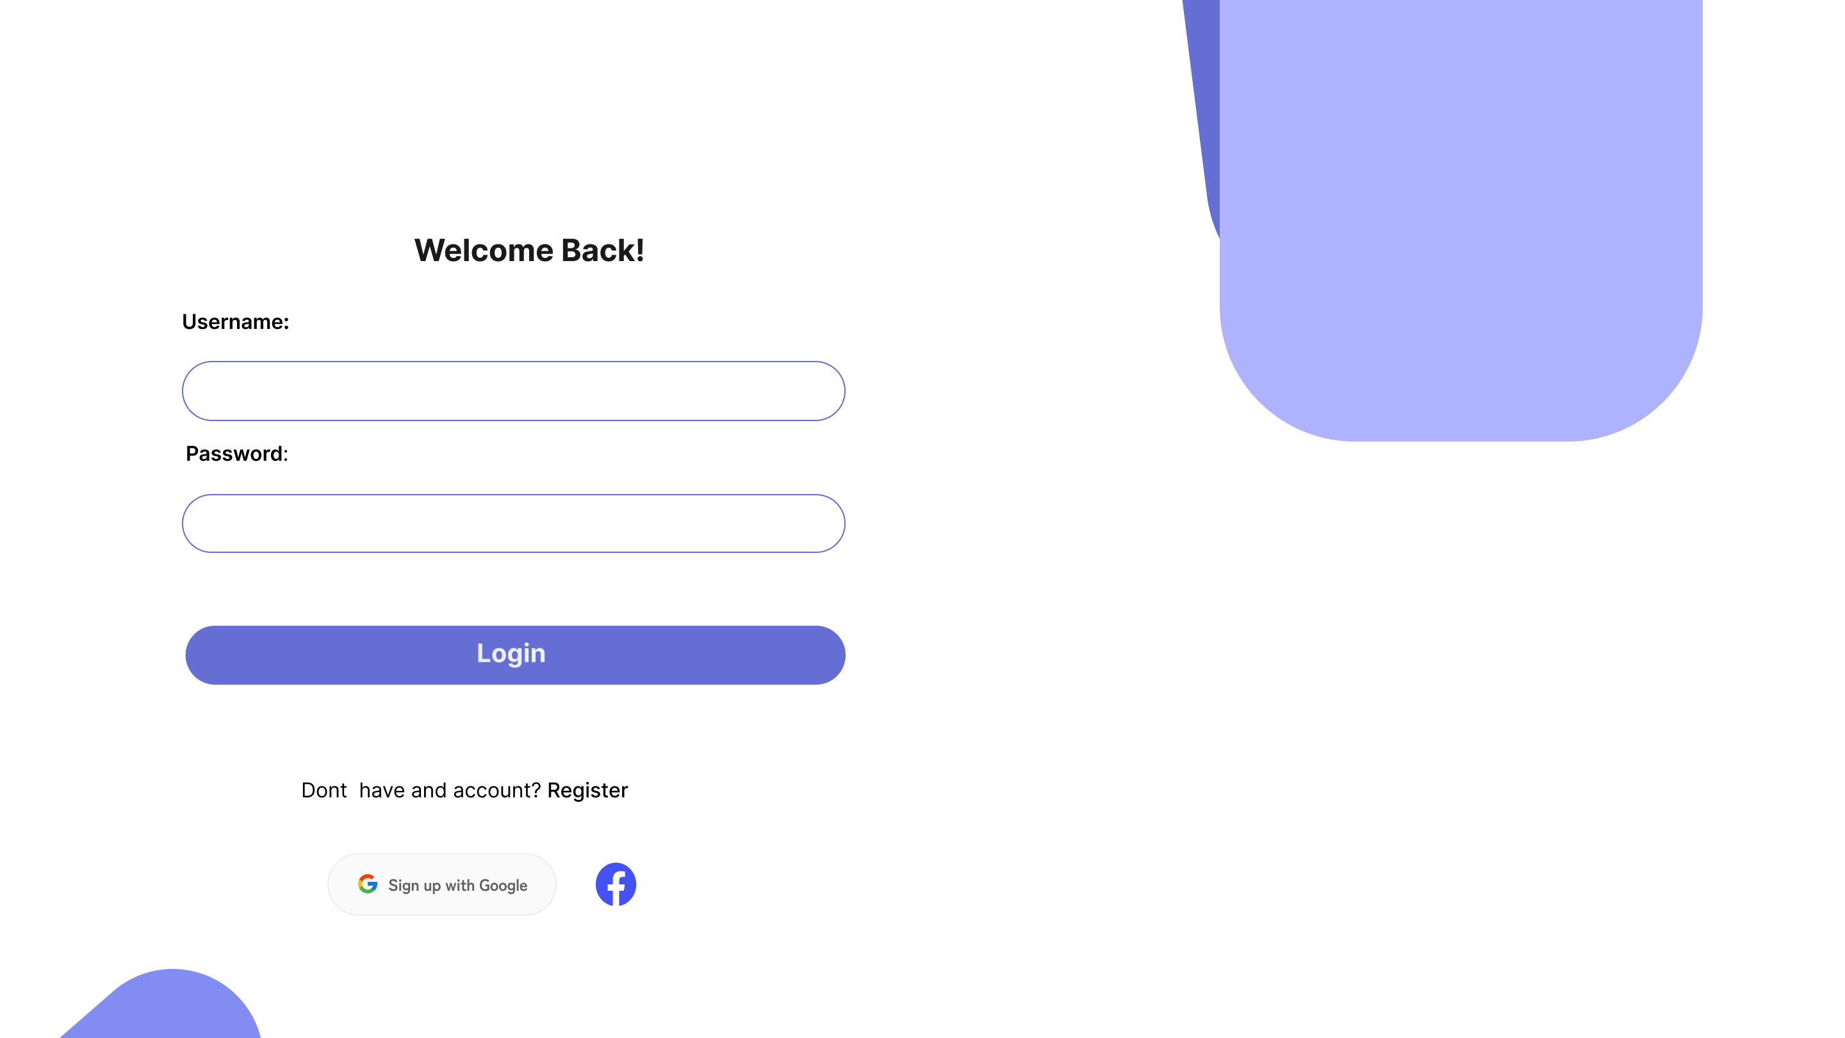
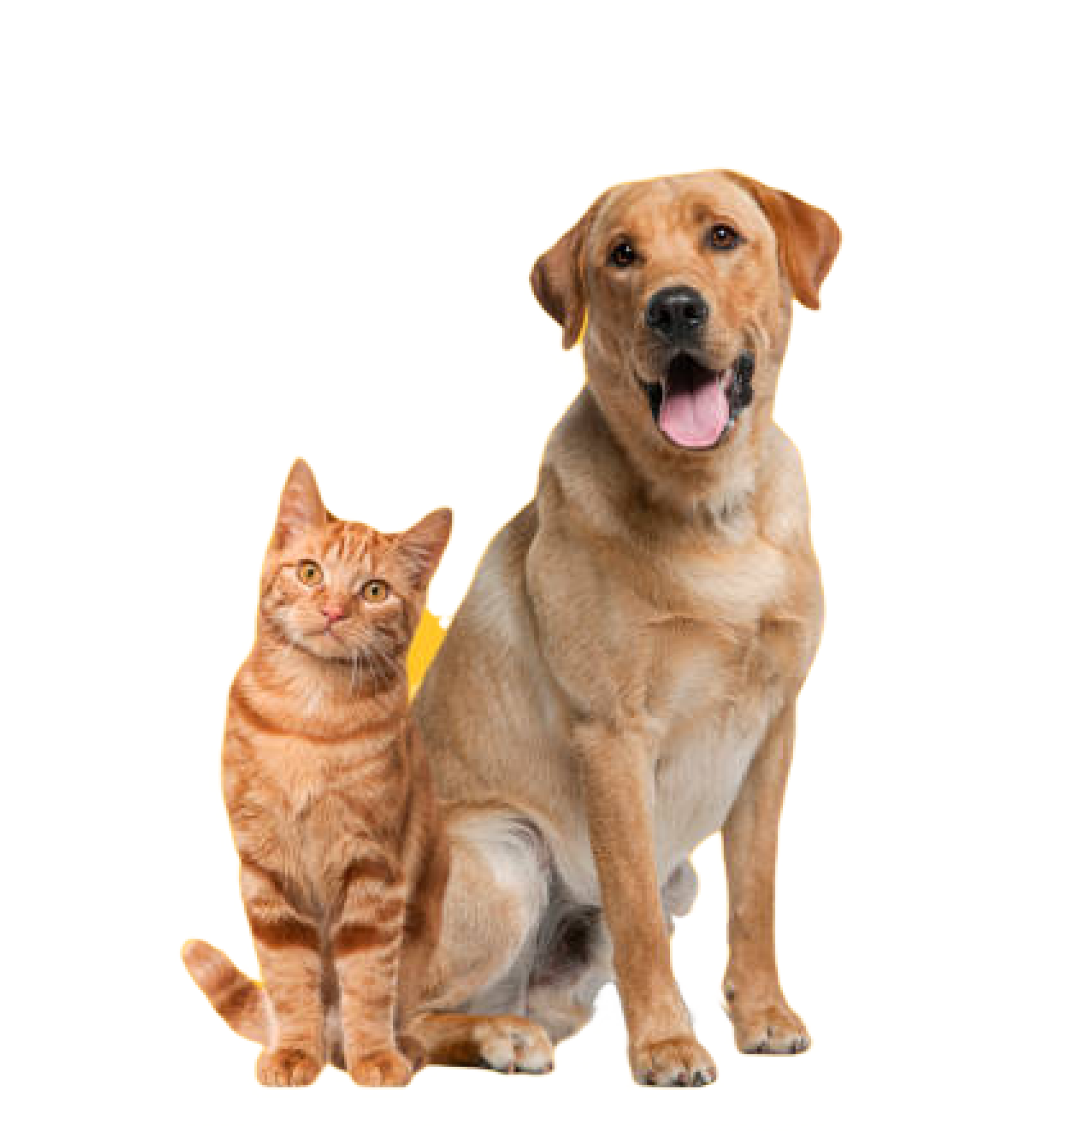
Login Page

Slide 50
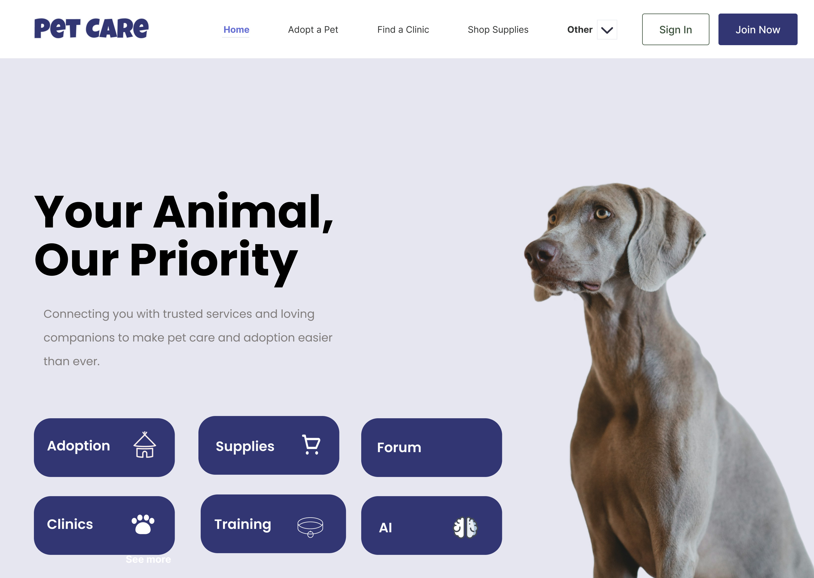
Home Page

Slide 51
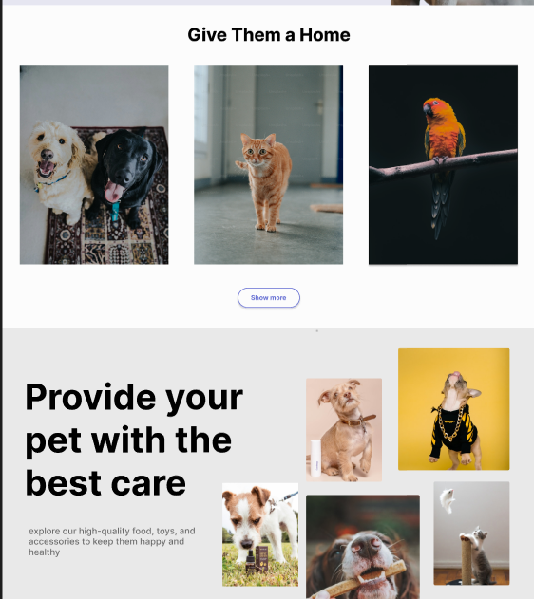
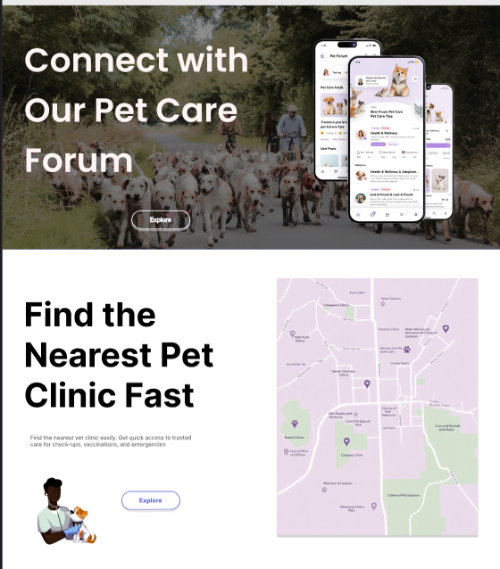

Slide 52



Slide 53


Adoption
Page

Slide 54




Slide 55





Slide 56



Shop Page

Slide 57





Slide 58

Community
Page

Slide 59


Clinic Page

Slide 60


Training Page

Slide 61



Slide 62


Traveling Page

Slide 63


AI Moguls Page

Slide 64



Adoption
Likelihood Predictor

Slide 65


pet
Health
Checker

Slide 66


Pet
Price Predictor

Slide 67



Doctor
Train
Edite
Profiles Page

Slide 68

Contact US Page

Slide 69

About US Page

Slide 70
Testing & Evaluation

Slide 71
Testing Strategies
Unit Testing
Goal: Validate individual functions in isolation
Frontend: Jest (for React components like pet profile display, form validation)
Backend: Mocha and Chai (for Node.js/Express APIs like /api/pets/create)
Coverage: Over 95% of critical functions
Example: Testing the createPet function to ensure input validation and correct MongoDB storage
Integration Testing
Goal: Ensure seamless interaction between modules via RESTful APIs
Tools: Postman, Supertest
Example: Test user login followed by pet creation and reminder scheduling to ensure smooth data flow
User Testing
Goal: Assess usability, interface design, and functionality
Method: Beta testing with 20 pet owners for 2 weeks; feedback collected via surveys
Tools: Google Analytics to track usage
Example: Users appreciated health tracking visuals; suggested mobile app version

Slide 72

Performance Metrics
200ms
2s
1,000
85%
API Response Time
Frontend Load Times
Concurrent Users
User Satisfaction
averaged (tested via Postman and New Relic)
kept under using React lazy loading and code splitting
Simulated up to using JMeter
of beta testers rated usability as "excellent" or "very good"
Accuracy
Verified integrity of CRUD operations across MongoDB collections
Example: Updating a pet’s vaccination record reflected correctly in both backend and frontend
Speed
Image optimization via Cloudinary for performance
Scalability
MongoDB sharding and indexing ensured stability
Stress test with 2,000 users showed only slight delay (up to 300ms)
User Satisfaction
Positive feedback on interface and health tracking; suggestions included offline mode and push notifications

Slide 73
Comparison with Existing Solutions (Part 1)
Health Tracking
Yes (with trend visualization)
No
No
Pet Profiles
Yes
No
Limited
Reminders
Yes
No
No
Community Forum
Yes
No
No
Informational Content
Basic tips included
Extensive
Some
Summary: Pets Care offers a comprehensive, integrated pet management platform, unlike PetMD (information-only) and Rover (service-focused).

Slide 74
Comparison with Existing Solutions (Part 2)
User-Friendliness
Unique Features
Technical Superiority
Pets Care: Simple, intuitive interface using React; drag-and-drop for reminders
Health tracking with chart visualizations (e.g., weight trends using Chart.js)
Built with scalable technologies (Node.js, MongoDB)
Modular system architecture with RESTful APIs
PetMD: Article-based layout, no personalization
Ability to share data with veterinarians
Designed for extensibility and real-time interaction
Rover: Designed for booking services; less intuitive for general pet care
Built-in community forum for peer advice

Slide 75
Results & Discussion

Slide 76

Summary of Findings: System Performance
95%
4.5/5
100%
85%
Profile Creation
Health Tracking
Reminders
Satisfaction
Users successfully created profiles.
Rated useful by testers.
Reliable notification delivery.
Overall user satisfaction rate.

Slide 77
Summary of Findings: AI Model Results
Pet Price Prediction
Adoption Prediction
Animal Danger Level
Cat vs. Dog Image
Best Model: XGBoost Regressor.
Best Model: Decision Tree Classifier.
Best Model: Decision Tree Classifier.
Model: MobileNetV2 with TensorFlow.
Metrics: MAE, MSE, R² Score.
Metrics: Accuracy, Precision, Recall, F1-score.
Binary classification: Dangerous vs. Not Dangerous.
High accuracy via transfer learning.

Slide 78
AI Model for Predicting Pet Prices
AI Model for Predicting Animal Danger Level
AI Model for Predicting Pet Adoption Possibility
Evaluation Metrics

Slide 79

Interpretation of Results
1
Main Objective Achieved
Core features fully integrated.
2
Specific Objectives Met
Profiles, reminders, health tracking effective.
3
System Conclusion
Effective, modular, user-friendly.
4
Improvement Needed
Community engagement requires focus.

Slide 80



Limitations:
Limited AI Integration
Static advice, lacks personalization.
Scalability Concerns
Slower response under heavy load.
No Native Mobile App
Users prefer offline access.
Community Engagement
Low forum participation (20%). Lack of gamification/incentives.
Offline Functionality
No support for offline use.
Web-based, internet dependent.

Slide 81
Conclusion & Future Work

Slide 82
Summary of Contributions
The Pets Care system provides a structured and effective solution for managing pet health. Key contributions include:
Integrated Modular Design Combines pet profiles, health tracking, and reminder functionalities within a unified platform.
Responsive Interface Developed using React.js, ensuring compatibility and usability across various devices.
Secure Data Management Implements JWT-based user authentication and MongoDB for reliable and secure data storage.
Community Interaction Includes a discussion forum to facilitate the exchange of pet care knowledge among users.

Slide 83





Future Work and Enhancements
Mobile Application Development
Build a native app using React Native to increase accessibility and user engagement.
Artificial Intelligence Integration
Apply machine learning techniques to offer personalized care recommendations based on pet data.
Community Feature Expansion
Introduce user engagement mechanisms such as activity tracking and participation incentives.
IoT Device Support
Integrate with smart pet care devices to enable real-time health monitoring and automated data logging.
Scalability Optimization
Enhance backend performance with advanced load balancing and database sharding to support larger user bases.
Planned improvements to extend system functionality and reach include:

Slide 84
References

Slide 85
[1] PetSmart. Available at: https://www.petsmart.com. Last accessed: April 9, 2025.
[2] Petco. Available at: https://www.petco.com. Last accessed: April 9, 2025.
[3] Chewy. Available at: https://www.chewy.com. Last accessed: April 9, 2025.
[4] Petfinder. Available at: https://www.petfinder.com. Last accessed: April 9, 2025.
[5] Vetstreet. Available at: https://www.vetstreet.com. Last accessed: April 9, 2025.
[6] Zoolker. Available at: https://www.zoolker.com. Last accessed: April 9, 2025.
[7] Aleef. Available at: https://www.aleef.com. Last accessed: April 9, 2025.
[8] URL (Images Pets Model)
[9] URL (Pet Adoption Model)
[10] URL (Pet Price Model)
[11] URL (Pet Danger Model)

Slide 86
Thanks For Listening..
Any Questions..?

